Slide 1
INFO 250 Information Visualization
Week 4A: More about ontologies

Slide 2
Overview of the week
The major topic of this week is grammar of graphics, the last major framework that is going to be discussed in this class.
Before moving to grammar of graphics, I am going to finish the review of basic graphic types that we have not finished.

Slide 3
Project 1C: Summarizing graph types
Due Date: 10/18/2021 (Monday) midnight 11:59pm EST
Tasks: Creating a matrix to compare five graph types that you select (instructions see below) in terms of:
Can this graph type be created in RAW, Tableau, ggplot (https://ggplot2.tidyverse.org/reference/index.html) and Google Charts (https://developers.google.com/chart/interactive/docs/gallery)? And what names are they called in these systems?
What visual patterns can be meaningfully used in each graph type? (Answer this question based on the ontology of visual patterns in this week's class.)
What type of data should be used to create each graph type? (Connect your answer to the ontology of data complexity, proposed by Shneiderman)
For each graph type, think of two general questions one can answer using the graph.

Slide 4
Project 1C: Summarizing graph types
Other requirements:
You can choose any five graph types either covered by the class or not.
Some graph types may not have the same name in the four sources.
Please only submit one written report with the matrix.
The content of this assignment will also be covered by the mid-term exam next week.

Slide 5
Project 1C: An example
 | Bar chart | Scatter plot | Box plot | … | …
System support | - RAW: Bar chart - Tableau: Horizontal bars, Stacked bars, and Side-by-side bars …
Visual patterns | - Size - Color …
Data types | - 2-dimensional (numeric x categorical)
Questions | - 1. How objects are compared in terms of the number? - 2. How different subcategories within a group are different in the number?
Notes:
You do not have to follow the exact same example, but I want a matrix with these four questions addressed following my specifications.

Slide 6
Some analytical frameworks for InfoVis
Data value types:
Numeric (nominal, ordinal, interval, and ratio)
Categorical
Datetime
…
Data/visual complexity:
1-d: pie chart, histogram…
2-d: line chart, scatterplot…
3-d:
Temporal:
Multi-dimensional
Tree or Structured
Network
User tasks:
…

Slide 7
Schedule for the coming weeks (I)
Week 5:
The first class will be about R after finishing 4B.
The second class will be the take-home mid-term exam, which will be broadly about everything that we have discussed in the first four weeks and NOT about R.

Slide 8
Multi-dimensional graph:
Even though we can always represent data beyond two dimensions by adding multiple visual pattern to a two-dimensional graph (such as color, size, grouping…), there are a few graph types that are designed for multi-dimensional data (i.e., dataset with more than three variables to be visualized).
The most popular graph type in this category is the radar chart (also called spider chart or radial chart).

Slide 9
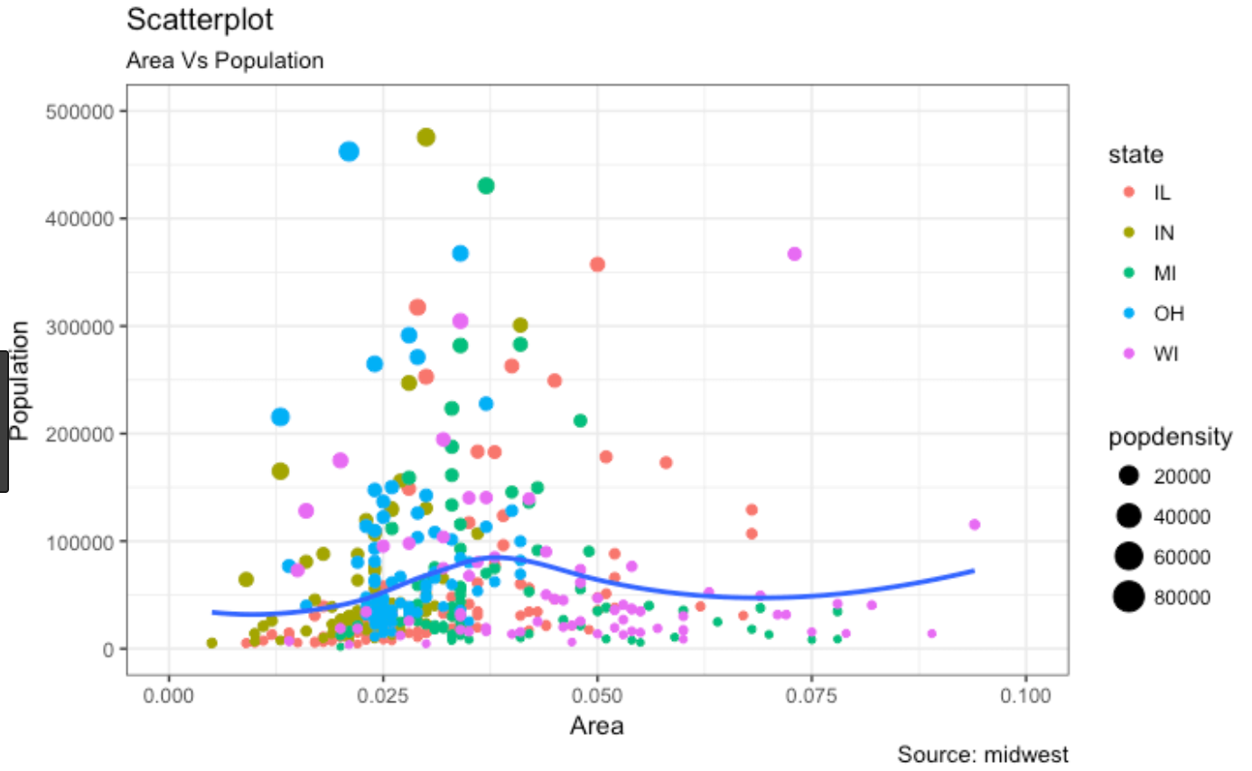
So why should we use multi-dimensional graph types?

Slide 10
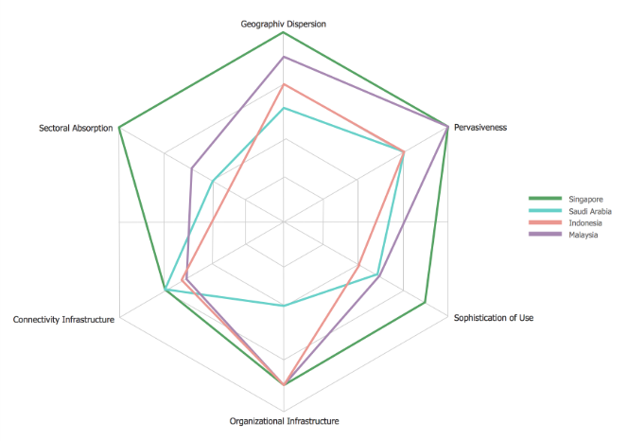
Radar chart
Radar chart (or spider chart) is the most popular multi-dimensional graph type.
Two questions can be answered by radar chart:
How individuals are compared in all parameters in the graph?
How is one’s overall performance?
What are the cons of this graph?

Slide 11
Temporal (timeline) visualization
Temporal data can be incorporated into many different graph types, so it does not need to be regarded as a separate graph type.
However, when temporal data is used in the graph, it is mostly plotted as the x-axis.
http://www.evolutionoftheweb.com/

Slide 12
Tree graphs
Tree graph is a category of graph types displaying the hierarchical structure in the data.
Some common graph types in this category include tree map, sun burst, and dendrogram.
Group | Member
A | A1
A | A2
A | A3
B | B1
B | B2
B | B3
B | B4

Slide 13
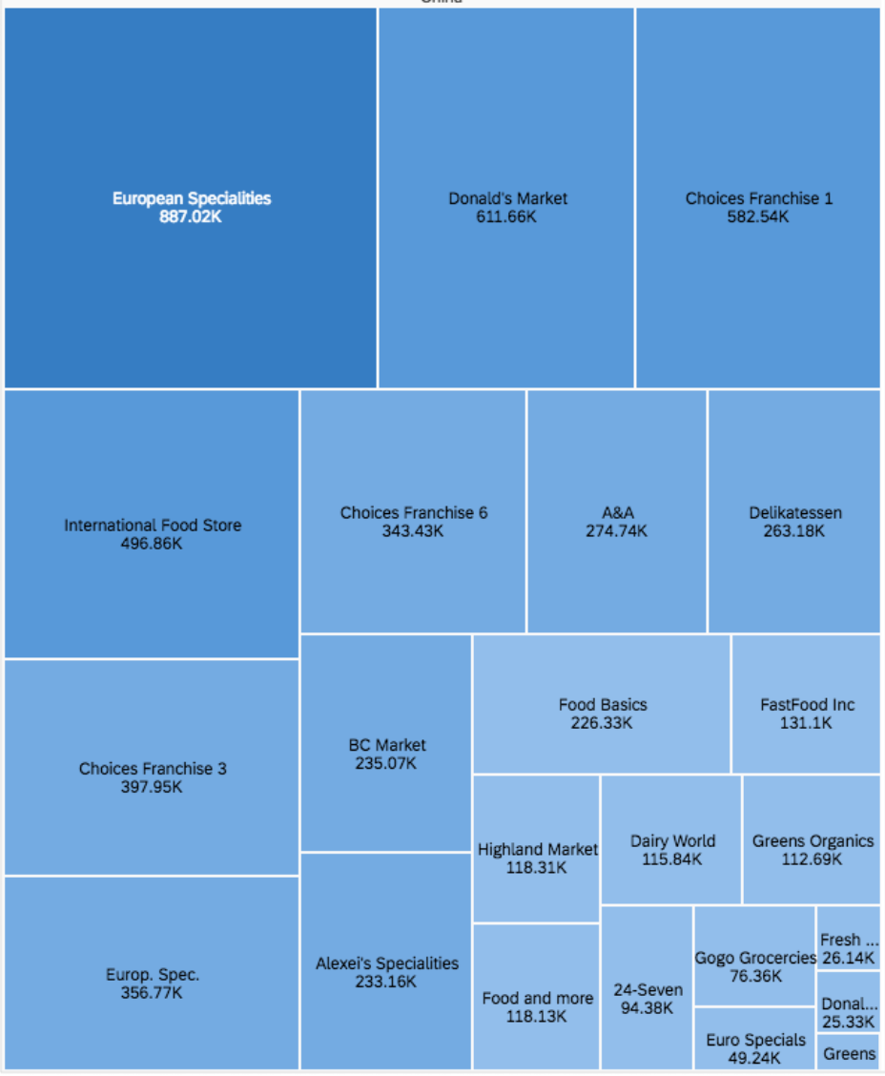
Tree map (I)
Tree map shows the sizes (quantitative) of categories (and subcategories) within a population.
It can be used to show multiple layers of hierarchies, but ideally no more than two.
It is bound by similar assumptions of the bar chart that all numbers are added up to the population.
Notes:
Square shapes

Slide 14
Tree map (II)
Budget is a natural object for the tree metaphor because it has many mutually-exclusive categories:
https://obamawhitehouse.archives.gov/interactive-budget
https://archive.nytimes.com/www.nytimes.com/interactive/2010/02/01/us/budget.html?src=tp (Flash required)
How would you compare these two graphs?

Slide 15
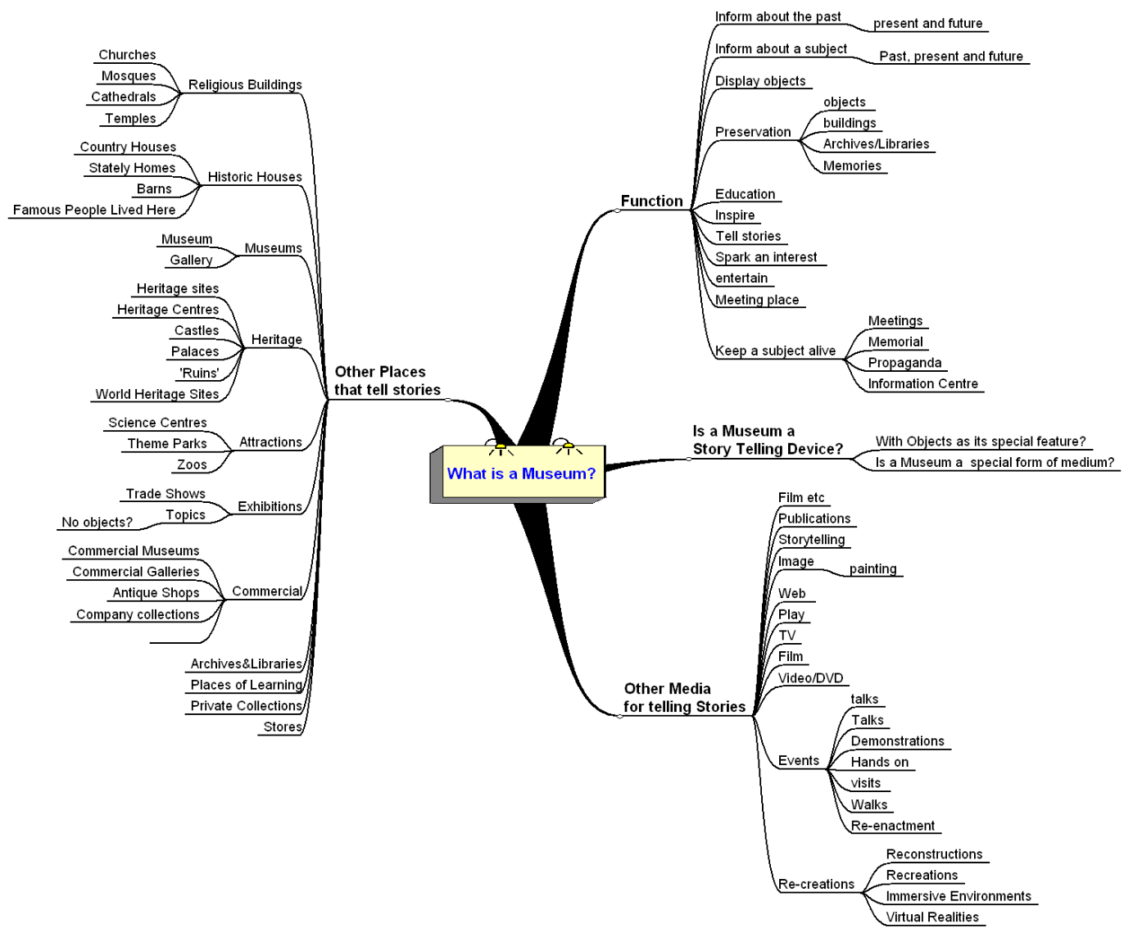
Dendrogram
Dendrogram is the graph type designed just to display the tree, rather than any numeric values.
It just shows how objects are structured together in the same organization system.
Notes:
Also the summability of market share

Slide 16
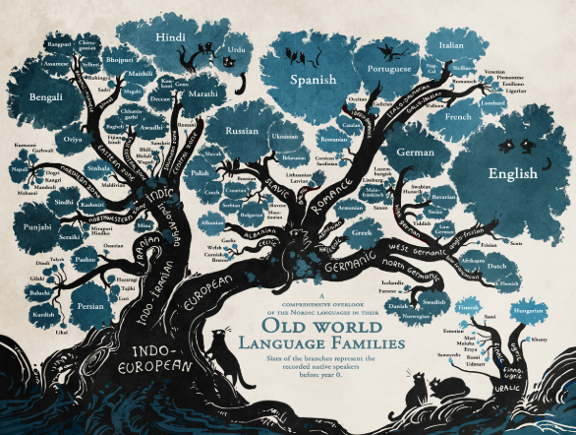
More about the tree graph
https://images.mentalfloss.com/sites/default/files/196.jpg

Slide 17
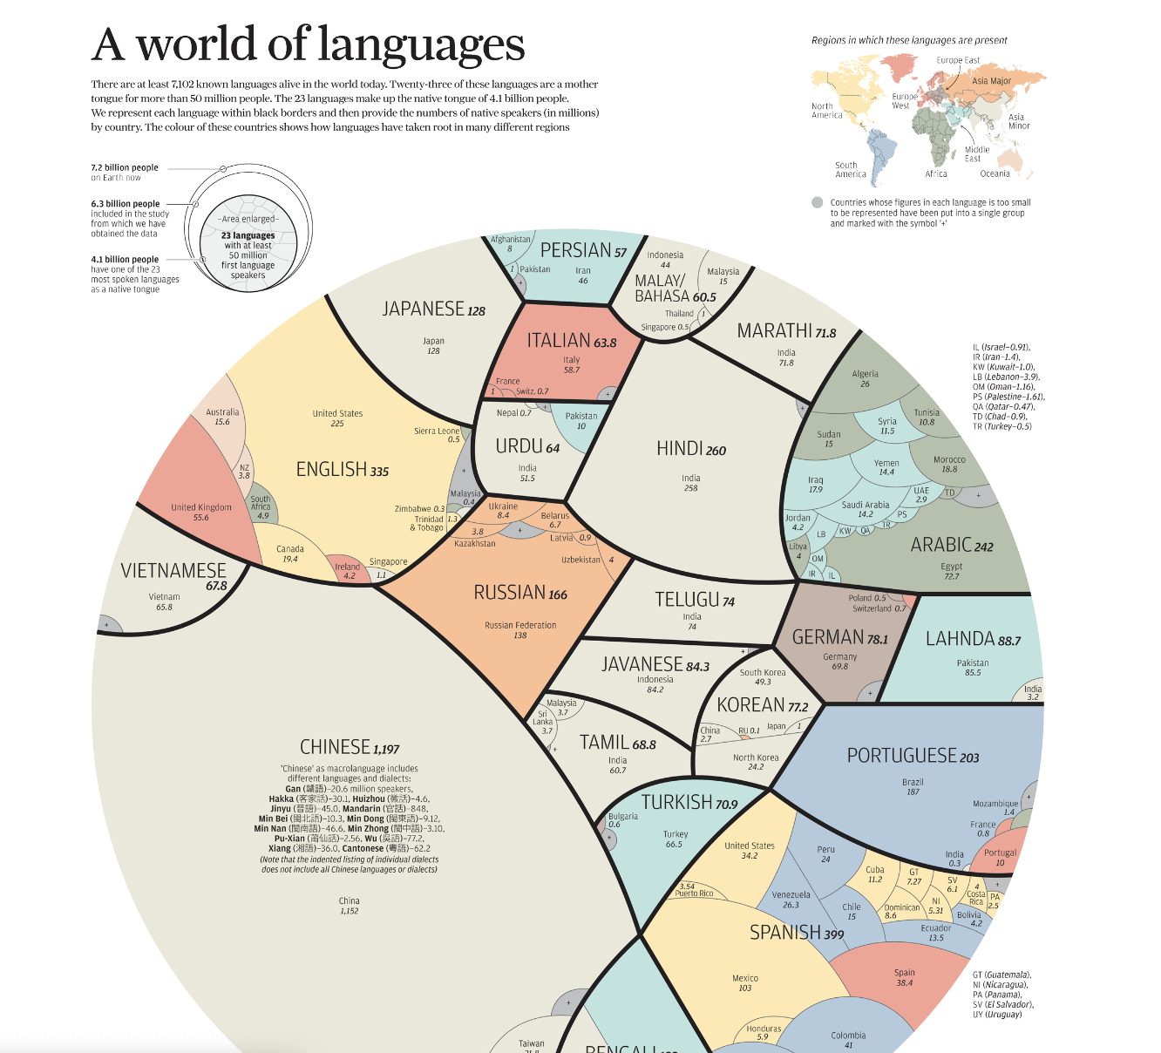
More about the tree graph
https://www.visualcapitalist.com/a-world-of-languages/

Slide 18
Network graph
Network graphs show the direct relationships between individuals and communities.
We will spend some dedicated time to talk about this graph type.
Some common graph types include:
Force-directed network graph
https://bl.ocks.org/heybignick/3faf257bbbbc7743bb72310d03b86ee8
Chord diagram
https://observablehq.com/@d3/chord-dependency-diagram
Sankey diagram
https://www.kenflerlage.com/2018/04/sankey-template.html
Correlational heat map
https://www.nytimes.com/2019/01/03/learning/whats-going-on-in-this-graph-jan-9-2019.html
They are often difficult to be created by common-purpose visualization tools (such as Tableau and ggplot). D3 is one of the most popular tools for this category.

Slide 19
Heat map
Heat map uses only color and/or shade to represent a value. Its meaning depends on the type of data values its two axes and the color/shade represent:
If both axes represent variables or observations, then the heat map is about the correlation between these variables or observations in the dataset.
Otherwise, it is about how observations perform along all variables.
Heatmap is very easy to be used along with other visual metaphors, such as the map and calendar.

Slide 20
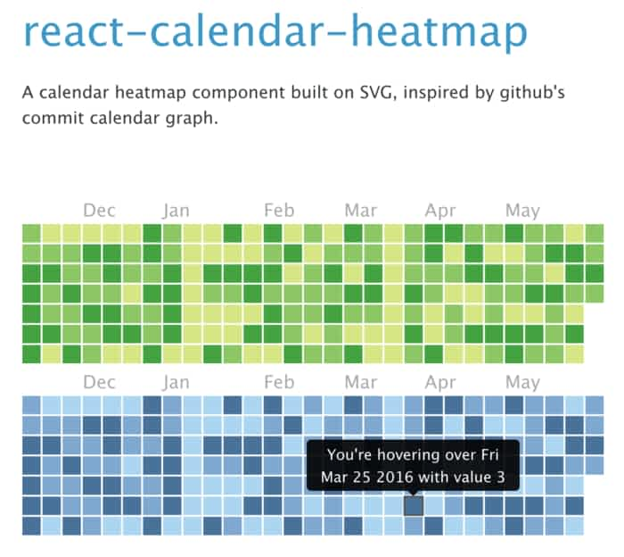
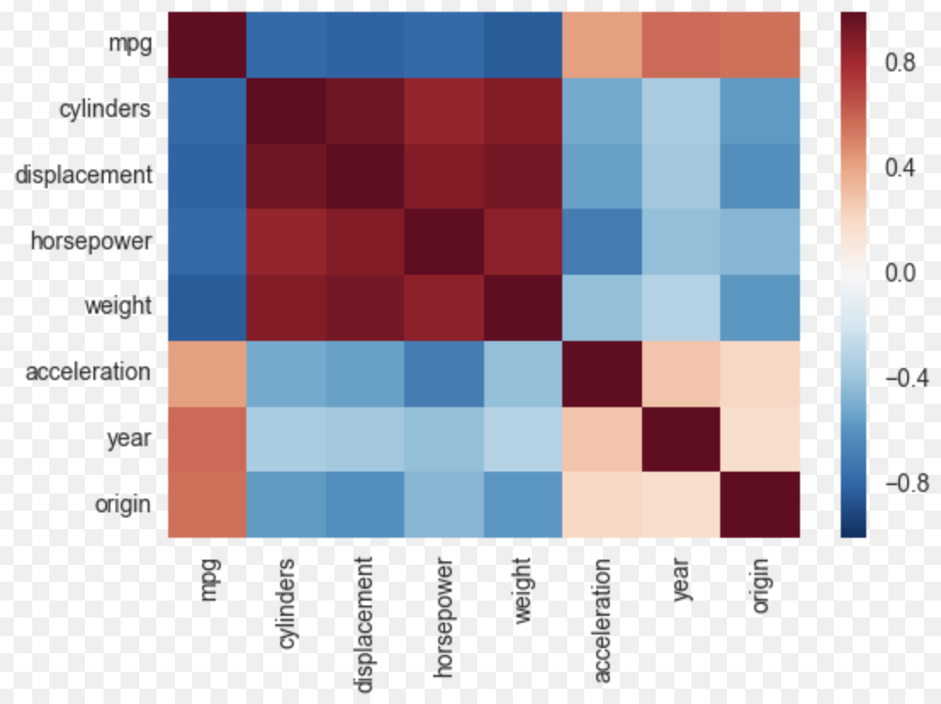
Heat map (II)

Slide 21
Different stories in the same dataset
https://flowingdata.com/2017/01/24/one-dataset-visualized-25-ways/

